Slide 1


Lesson: 01 Working with RHEL/CentOS 7
azaj.ikbal

Slide 2

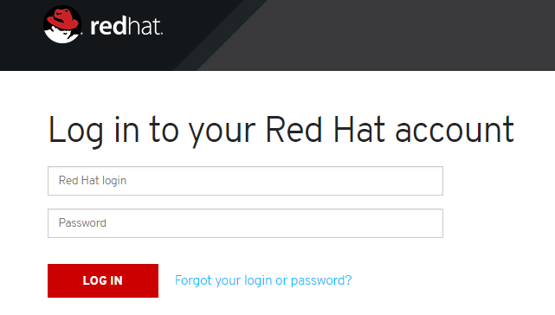


Downloading Fedora, RHEL/CentOS 7
https://fedoraproject.org
https://www.redhat.com
https://www.centos.org

Slide 3
System Requirements and Capabilities
Specification | Max Capabilities (x86_64)
CPU | 384
RAM | 12 TB
File System (ext4) | 50 TB
File System (xfs) | 500 TB
Specification | Minimum Requirements
CPU | 64 bit Intel, AMD, IBM Power7 or Z
RAM | 1GB/1GB per logical CPU
Disk | 10 GB/20 GB (Recommended)

Slide 4

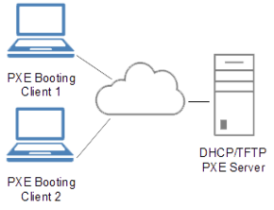

Installation Media Options
DVD Media
Bootable USB Flash Drive
Network-based Installation (PXE) – FTP/NFS/HTTP

Slide 5
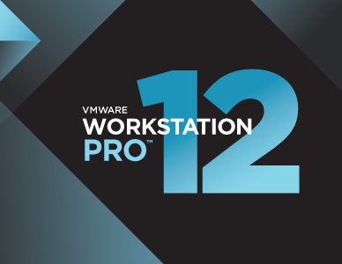
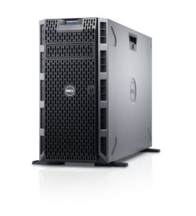
Installation Method
Virtual Environment
(VMware Workstation, KVM, Oracle virtual box)
Physical Server/Desktop
(Single boot/dual Boot)

Slide 6
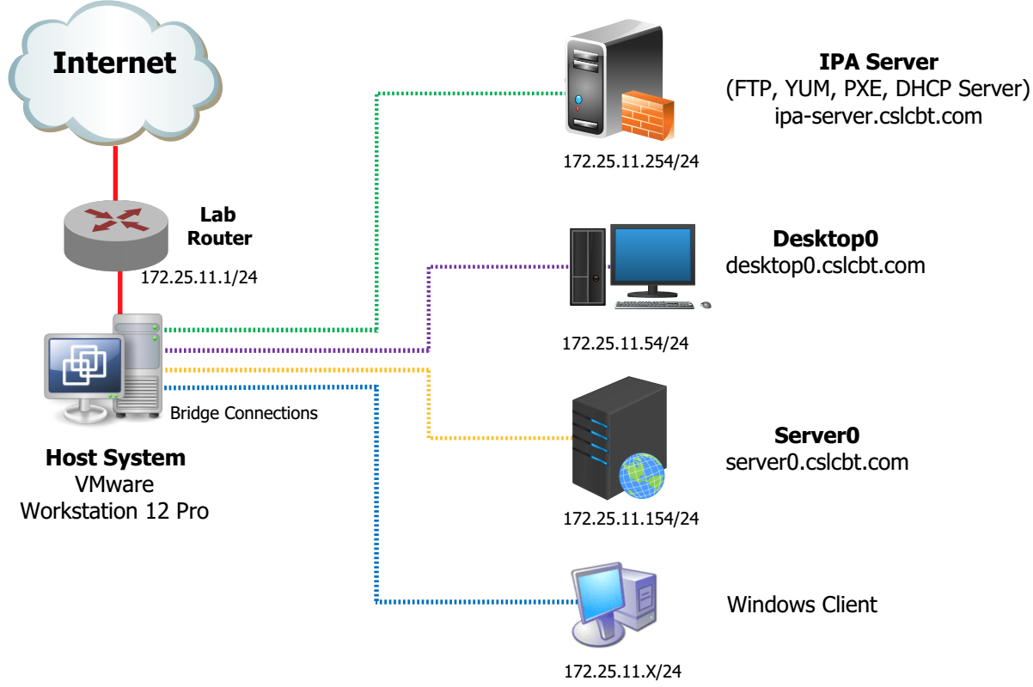
Lab Diagram

Slide 7
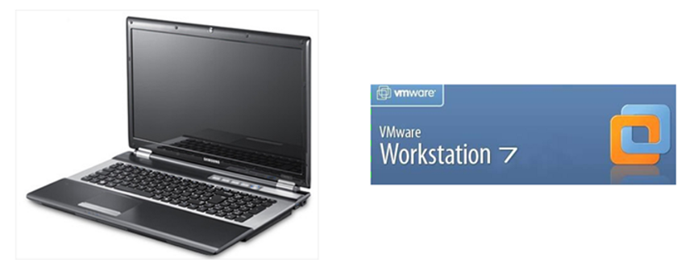
Virtual Lab Requirements
VMware Workstation 11 or Higher
Windows 7/8/10
Intel 64-bit CPU with VT Enabled
Min 4 GB RAM (8GB is Recommended)
50 GB Disk Space
1 NIC

Slide 8
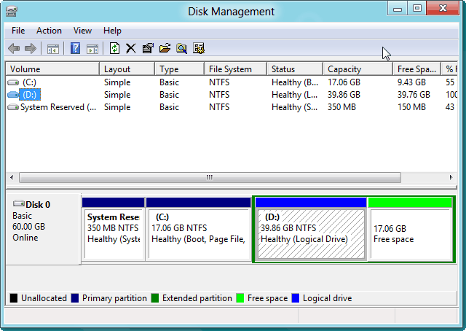
Partitioning - Dual Boot Installation

Slide 9
Planning the Installation
Partition or Mount point | File System Type | Partition Size
/boot | XFS | 500 MiB
/ | XFS | 10 GiB
/backup | XFS | 1 GiB
Swap | Swap | 2 GiB
Hostname – desktopX.cslcbt.com

Slide 10
Thank you

